Slide 1
AI Hotel Revenue Performance Analysis Dashboard
Power BI – Data Analysis Project
Presented by Bhavesh Santoshkumar Tupe

Slide 2
Problem Statement
Hotels face challenges in identifying and analyzing revenue-driving factors such as:
Seasonal fluctuations in bookings
Pricing and revenue performance (ADR, RevPAR)
Customer types and demand behavior
Effectiveness of booking channels
High cancellation impact on revenue
The goal is to build an interactive dashboard to analyze key insights
and support hotel management in revenue decision-making.

Slide 3
Project Objectives
✔ Analyze hotel booking data and revenue performance
✔ Identify key customer and booking channel insights
✔ Understand occupancy and pricing patterns
✔ Detect cancellation behavior and risks
✔ Provide business insights using Power BI dashboard

Slide 4
Dataset Source & Metadata
Dataset: Hotel Booking Demand Dataset
Source: Kaggle
Records after cleaning: 117,399
Number of Features: 32
Major Columns:
Hotel, ADR, Total Nights, Market Segment, Customer Type
Arrival Dates, Distribution Channel, Reservation Status

Slide 5
Data Cleaning
Data Cleaning Performed:
Removed rows with zero guests (invalid records)
Removed rows with ADR = 0 (incorrect revenue data)
Filled missing values (Children, Agent, Company, Country)
Created new analytical features:

Slide 6
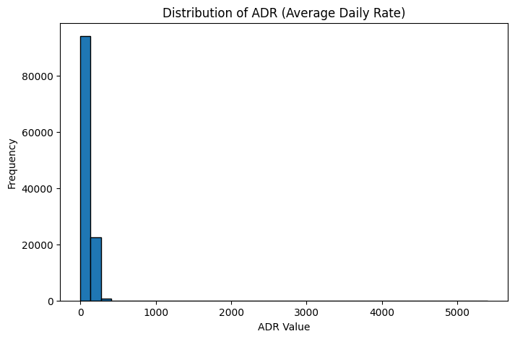
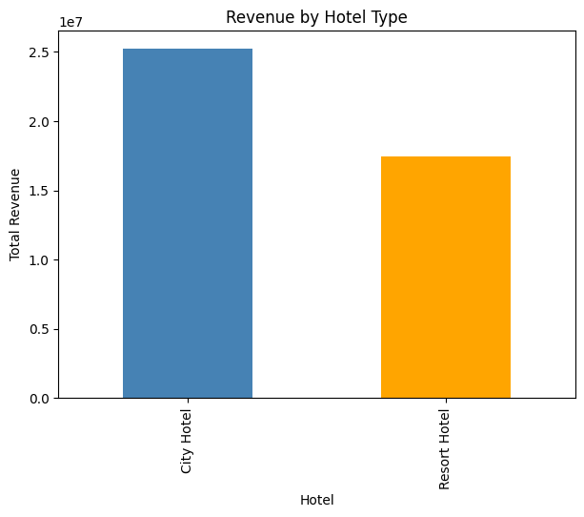
EDA Visuals

Slide 7
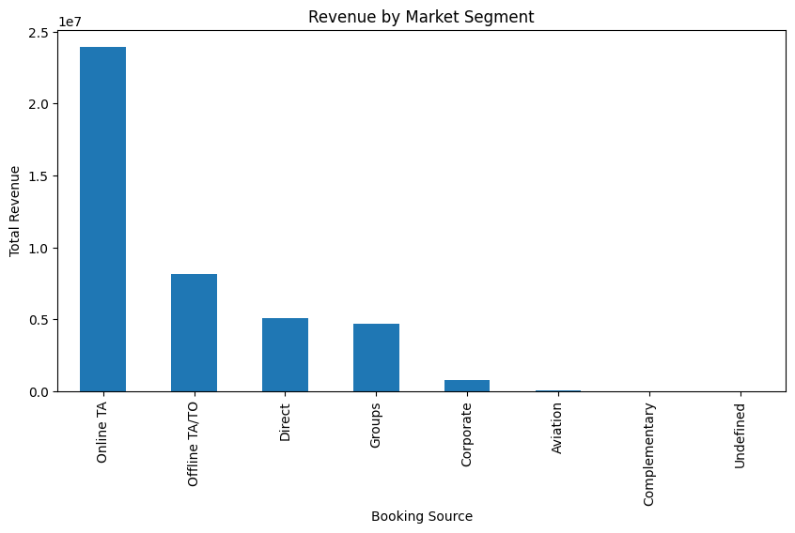
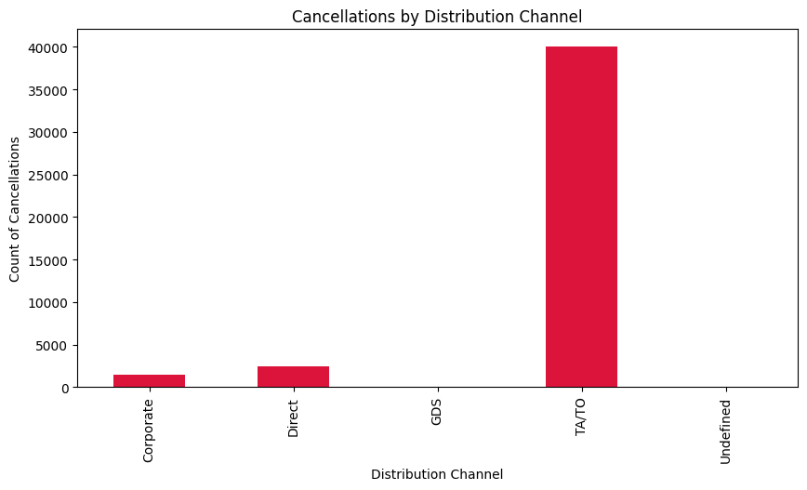
EDA Visuals

Slide 8
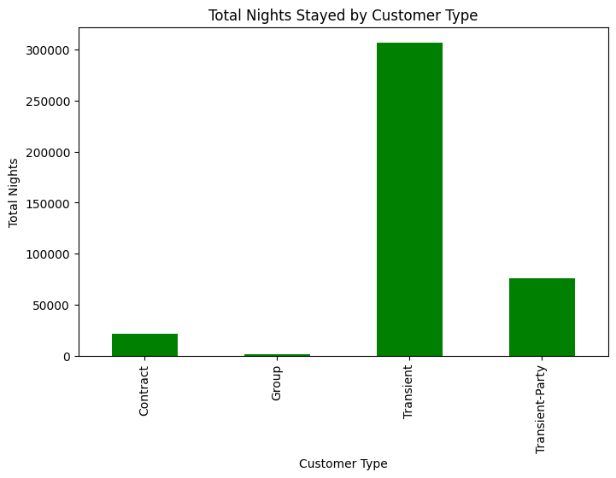
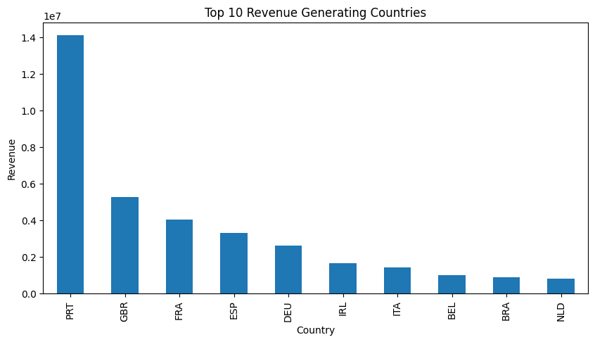
EDA Visuals

Slide 9
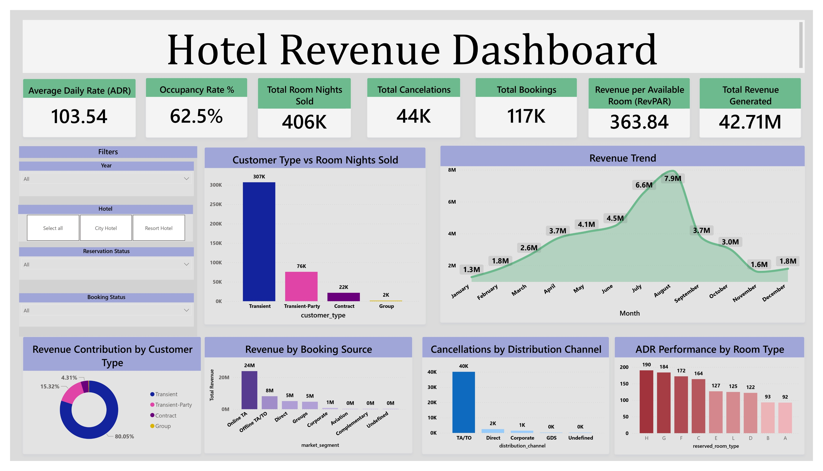

Slide 10
KPI Section
Power BI KPIs Used:
Total Revenue
Total Bookings
Total Room Nights Sold
ADR (Average Daily Rate)
Occupancy Rate
RevPAR (Revenue per Available Room)

Slide 11
Power BI Charts Section

Slide 12
Power BI Charts Section
Dashboard Filters/Slicers Applied:
Year
Hotel Type
Customer Type
Market Segment
These slicers allow users to dynamically explore different business scenarios.

Slide 13
Insights Summary
Insights Summary
Key Insights:
City Hotel generates higher overall revenue
Online (OTA) bookings bring more revenue but also more cancellations
Transient customers contribute highest room nights and revenue
Pricing varies with season and customer category
Distribution channel strongly impacts occupancy and revenue performance

Slide 14
Conclusion
Insights Summary
Conclusion:
Revenue analysis helps optimize pricing and demand strategy
Business should control OTA cancellations and focus on Direct bookings
Loyalty and promotional programs can target Transient customers
Seasonal patterns can help forecast resource planning
Future Scope:
Include API for real-time data updates
Add cost/profit analysis for financial accuracy

Slide 15
THANK YOU

